Slide 1

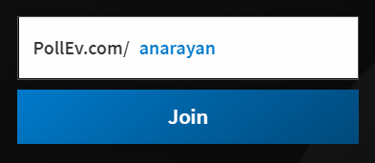
CS2113/T – Lecture 1
We are going to use the PollEverywhere for an in-lecture quiz.
Install the PollEverywhere app on your smartphone. Alternatively, you can submit responses at http://pollev.com/
Join the presentation http://pollev.com/anarayan
When prompted, use your NUSNET account to login
https://www.polleverywhere.com/mobile
This lecture will be recorded
This lecture will be recorded
Answer this question on PollEv.com:
In the context of today’s lecture, what are the things around you that are impacted by Software?

Slide 2

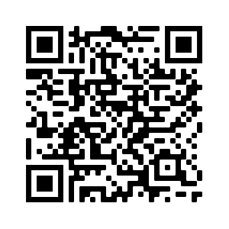
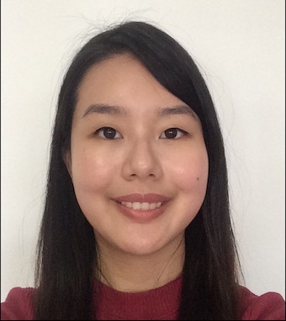
Teaching team
Akshay Narayan
Lecturer, SOC
Teaching: SE and AI (7 + 2)
Research: AI and Reinforcement learning
Before: TA 4 times; 3 yr Industry
Lew Yin Hui Stephanie
Graduate Tutor (Head TA), SOC
Tutors:
https://nus-cs2113-ay2021s2.github.io/website/admin/instructors.html

Slide 3
Zoom things!
Interactions & feedback:
Raise hands
Go slow, go fast
Reactions – yes, no, thumbs up
Lectures – not mandatory to have video on
Tutorials – yes
Mute by default, unmute to ask questions

Slide 4
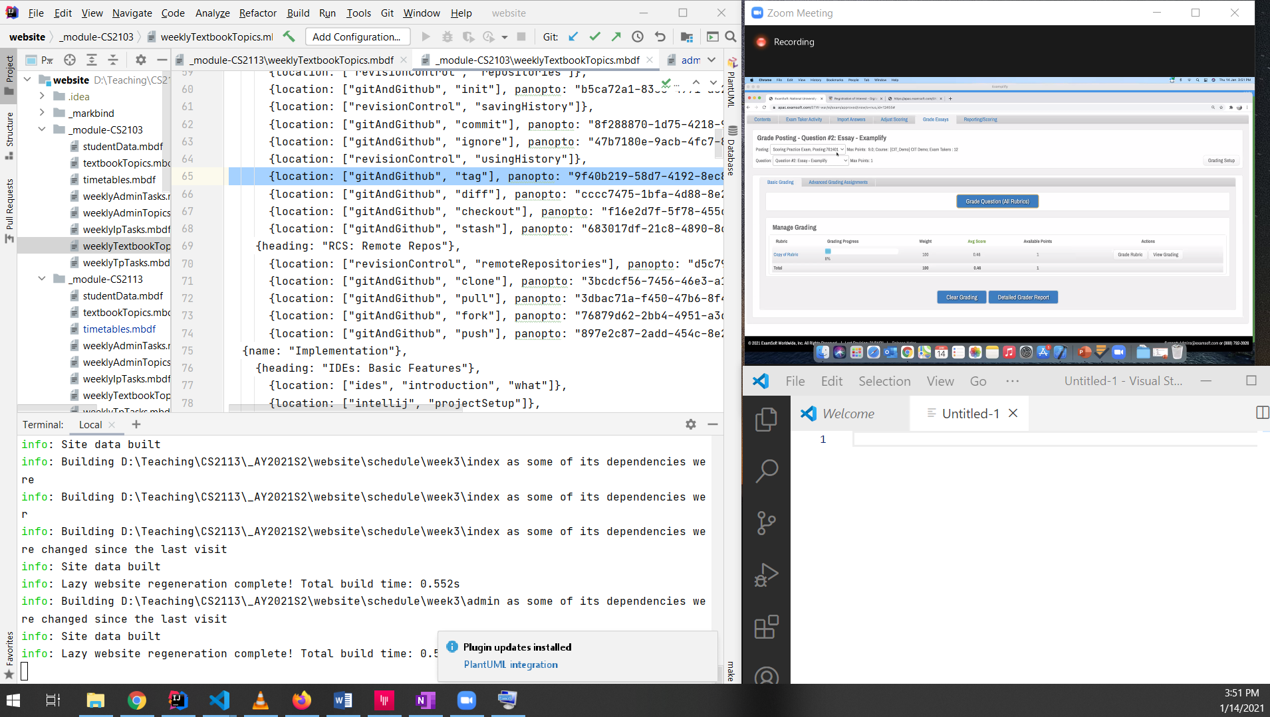
Zoom session
IDE / Sourcetree / cmd
Note taking

Slide 5
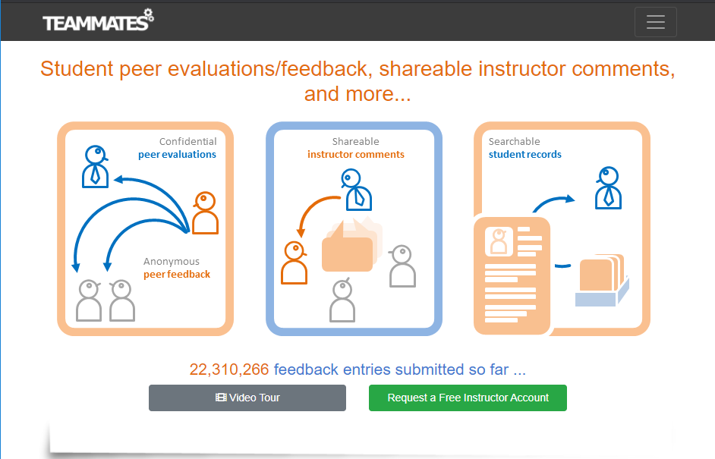

Slide 6
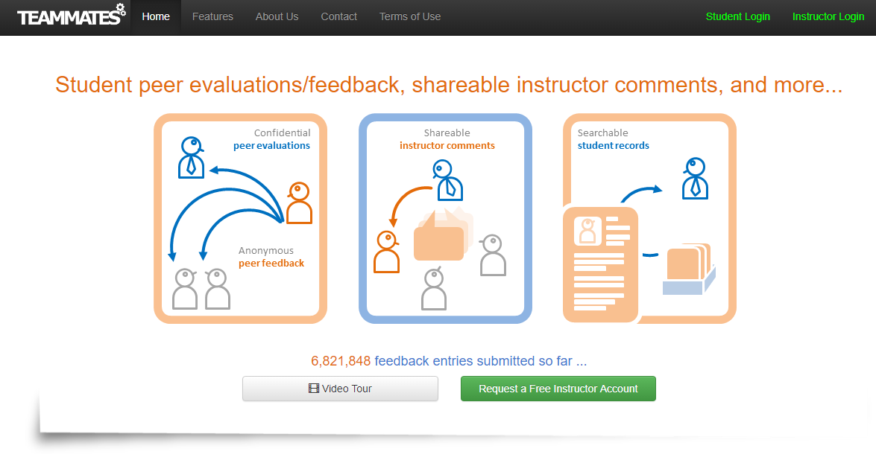
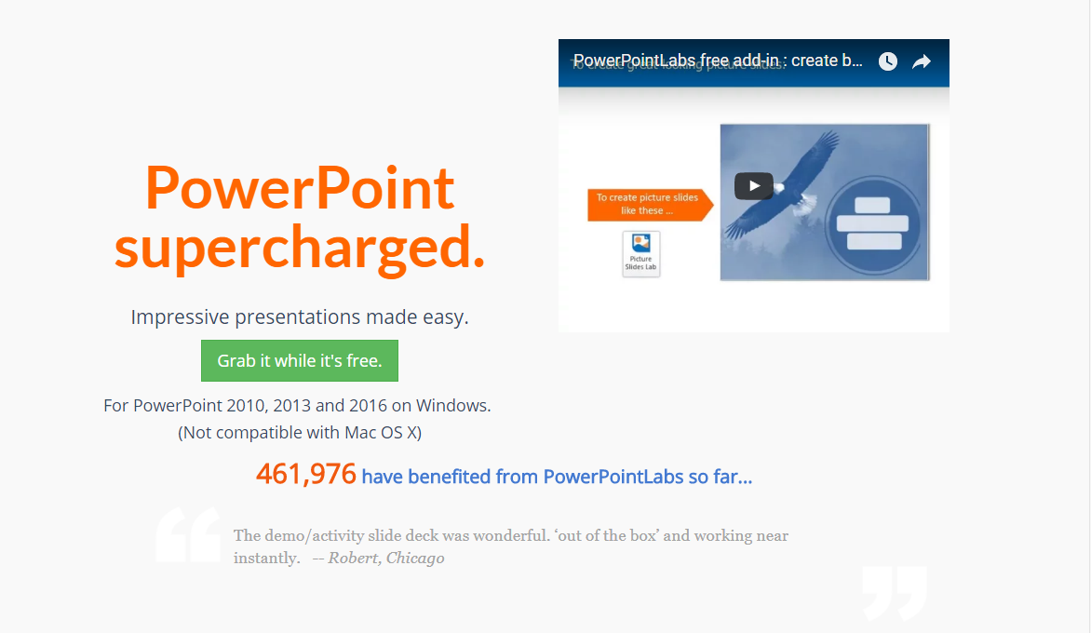

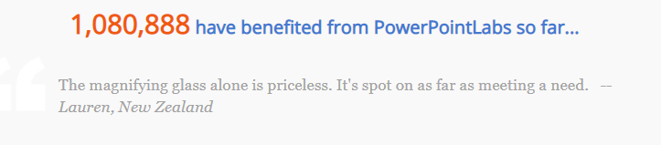
Over a million have used
500+ students have contributed code
More than 200 KLoC

Slide 7
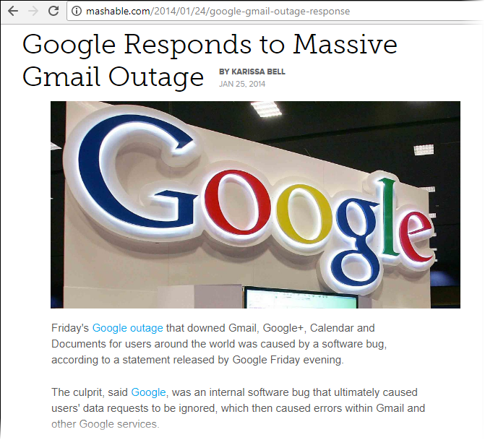
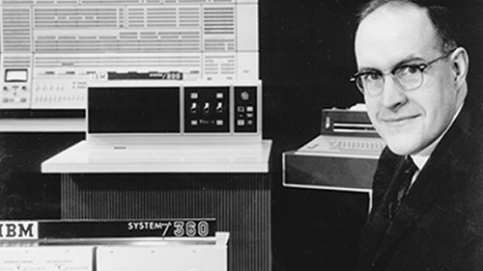


Software is powerful…
But, software is fragile!
Other pros and cons (read yourself!)

Slide 8

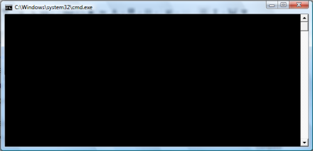


What is SE?
C:\ java HelloWorld
HelloWorld!
Application of a systematic, disciplined, quantifiable approach to the development, operation, and maintenance of software
SE = ‘Engineering’ of Software!
Required for large/complex Software
What’s the relevance to YOU?

Slide 9
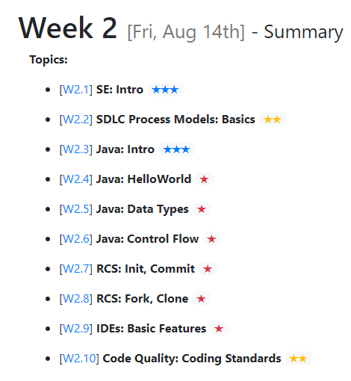

$←$✔

Slide 10
Why learn SE?
Long-term: some basic SE skills can help you maintain the balance of power in a project that involves other software engineers.
Short-term: to open more internship doors i.e., on paper, make you qualified for SE internships
Breadth and depth not meant to be similar to SE modules in the CS program!
CS2113 != CS2030 + CS2103

Slide 11
CS2113 != CS2030 + CS2103
1

Slide 12
Biggest worry/complaint: workload!
Common worry: new to Java!
Good news: Java is easier than C++
Start here! https://nus-cs2113-ay2021s2.github.io/website/se-book-adapted/chapters/cppToJava.html
Let’s fix that problem this semester.
What we have done:
Removed some topics e.g., Activity Diagrams
Reduced depth of many topics e.g., Architecture
Lowered project expectations
*[From the pre-module survey]

Slide 13
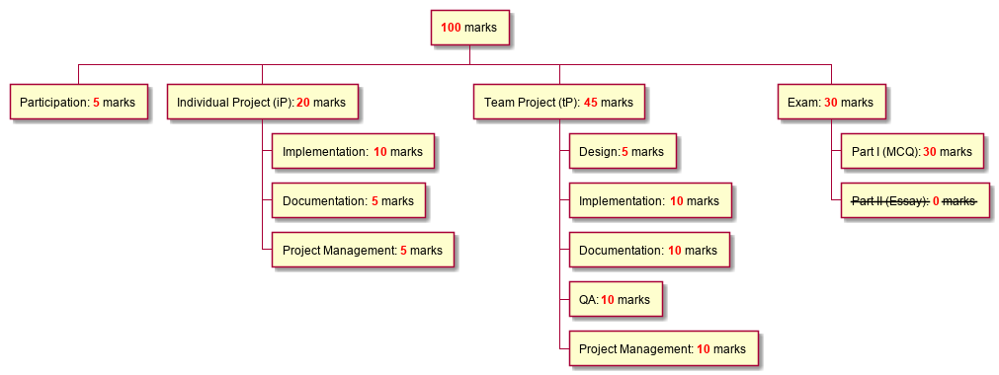
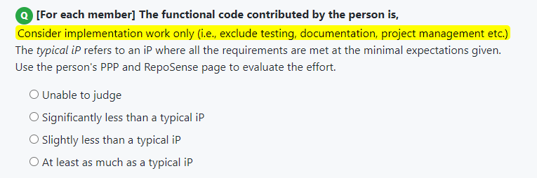
More on lowered project expectations:
No need to do more, but have to do it right!!

Slide 14
The module has been changed a lot since earlier semesters. Seniors’ advice might not work for this version!
2

Slide 15
Another worry: hard to get a good grade
☺ Good news: Last semester, ~ 40% received A- or above
Bad news: some did get unexpectedly low grades.
Usual tricks-of-the-trade might not work.

Slide 16
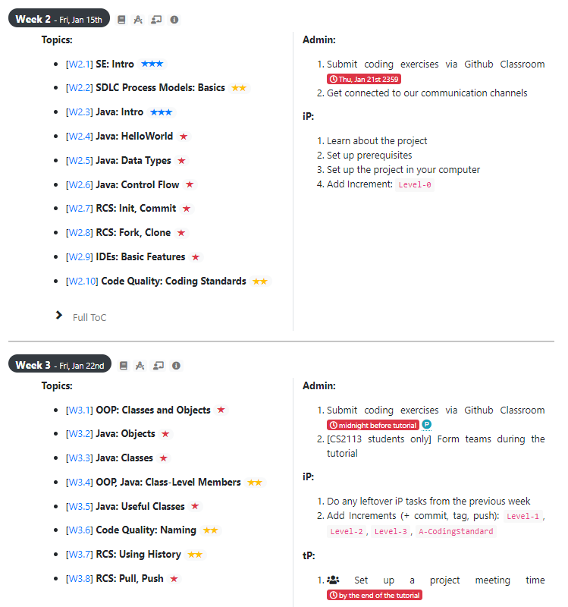
Weekly topics, tasks:
Learning the topics → you should be able to do the task
Doing the tasks doesn’t mean you learned the topics!
They don’t cover all topics.
They can be done in different ways.

Slide 17
Don’t fall behind. Don’t jump ahead!
3
Keen to do extra to make the future weeks easier? Invest that effort into the current week’s tasks.

Slide 18
The two projects: iP, tP
Java
OOP
IDE
Git & GitHub
Code Quality
Teamwork
Requirements
Testing, JUnit
Workflow
Documentation, UML
Individual Project (iP)
Team Project (tP)
Week 2 Week 6 Week 12
Which topic to cover first?

Slide 19
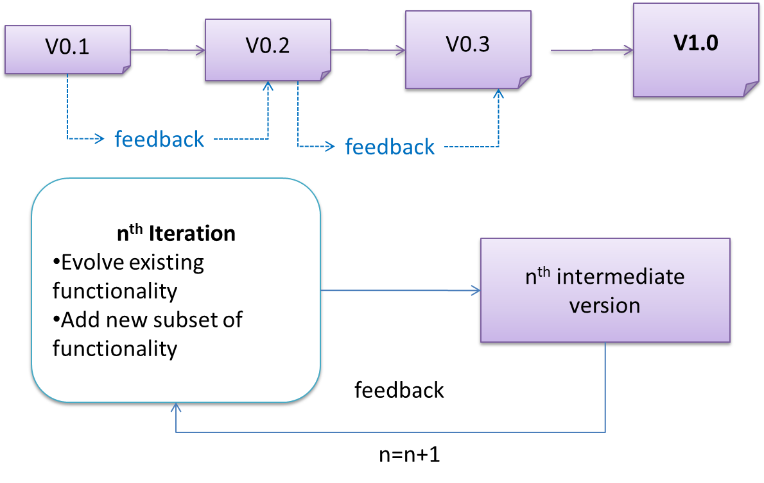
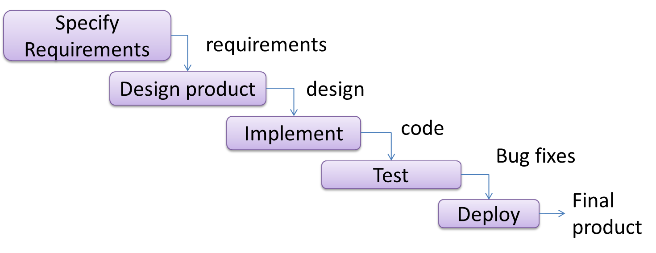
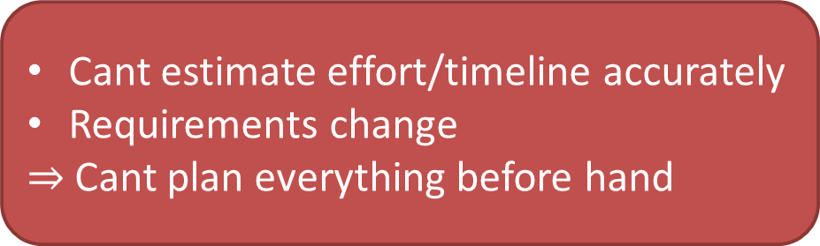
Ways to do Software Engineering
SDLC
Sequential
Iterative
Cleaner
Systematic
Requires things to be fixed
Cant estimate effort/timeline accurately
Requirements change
$⇒$Cant plan everything before hand
Harder
Repetitive
Better
This is what we do in the project!

Slide 20
Iterative Topic Coverage (not sequential)
Each week covering just enough for you to do the weekly tasks
Java, OOP
Requirements
Design
Implementation
Testing
Documentation
Project Management (Git, GitHub, …)

Slide 21

$←$✔
$←$✔

Slide 22
Going around in circles!!?? How to manage?

Slide 23
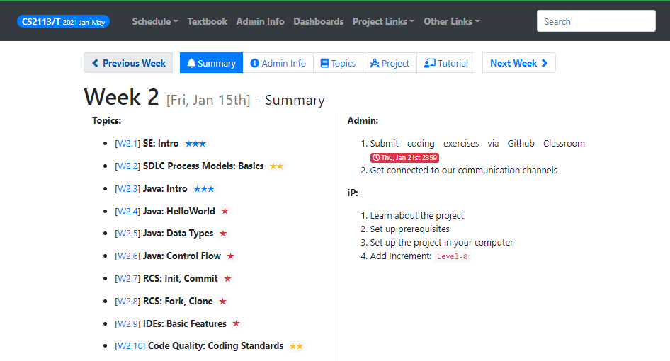
Module website to the rescue

Slide 24
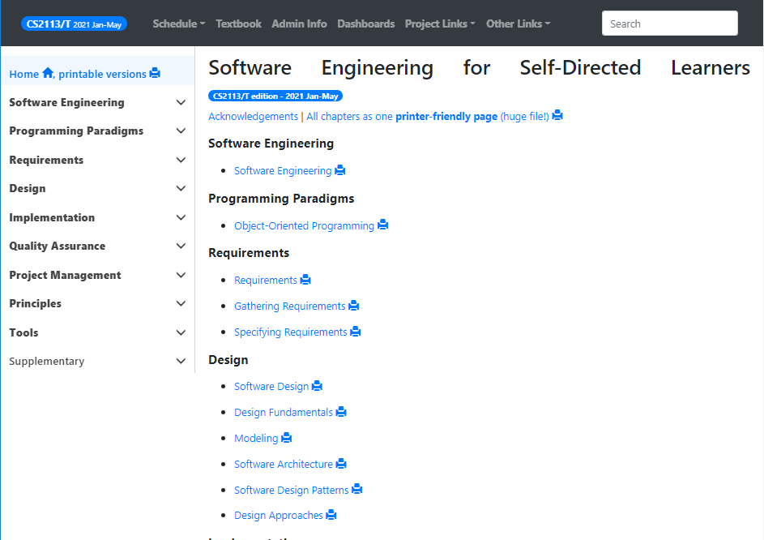
Textbook
PDF of the finalized version will be uploaded on LumiNUS by Week 3

Slide 25
Detailed instructions provided. Follow them!
1
CS2113 != CS2030 + CS2103
2
The module has changed. Seniors’ advice might not work!
3
Don’t fall behind. Don’t jump ahead!
4
5
If in doubt, ask (in the forum)

Slide 26
Weekly work cycle
Starts with the lecture
Week 2 starts today
highlights only
Read the weekly topics → do exercises/quizzes
Do project increments
Do other admin tasks
Attend tutorial
Wait, isn’t it more efficient to skip lectures and self-study
Reverse order is not recommended

Slide 27
If iP has low-value to you…
Java
OOP
IDE
Git & GitHub
Code Quality
Individual Project (iP)
Team Project (tP)
Week 2 Week 6 Week 12
Treat it as a refresher
Do just the minimal required for completion

Slide 28
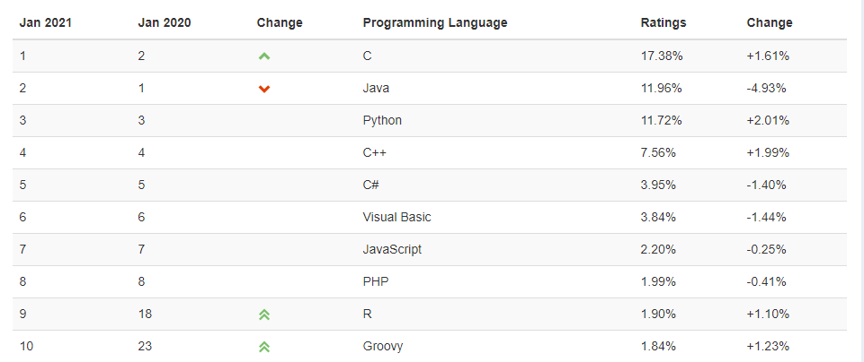
The programming language …
We use Java in CS2113/T
Source: https://www.tiobe.com/tiobe-index/
Well-established & mature
Used for big enterprise systems
Most popular OO language

Slide 29
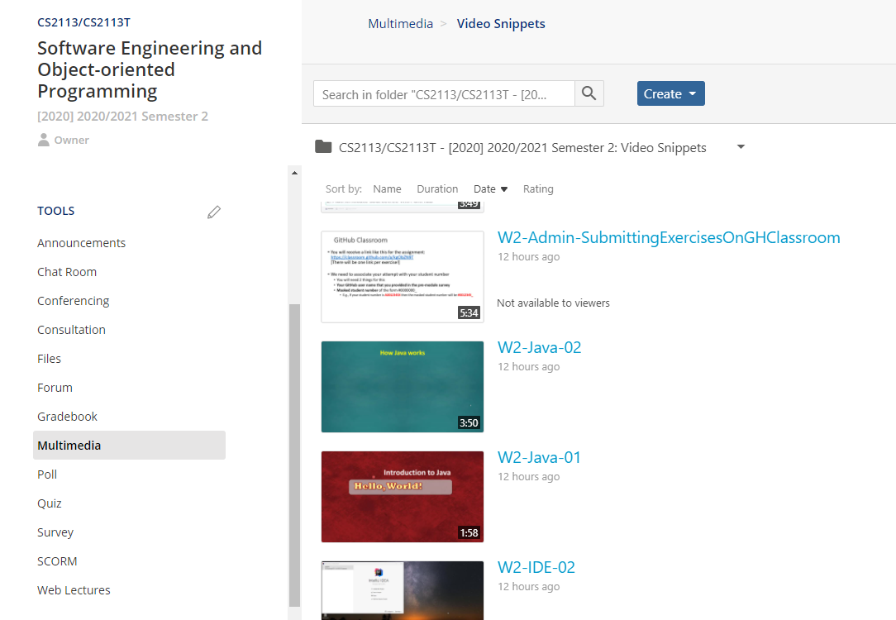
How Java works?
Watch:

Slide 30

$←$✔
$←$✔
$←$✔

Slide 31
Q: Java is __________ language
A compiled
An interpreted
The answer is actually both! We need to compile the source code, and interpret the object code.

Slide 32
Mode of delivery
6
Fully online
Exam – TBD

Slide 33
From next week
Videos released by Wedensday 2359
Watch snippets prior to the lecture
Ask questions on Archipelago
Lectures – short on content; hands-on + activities + consultation
Individual/Group consultations – drop me an email

Slide 34
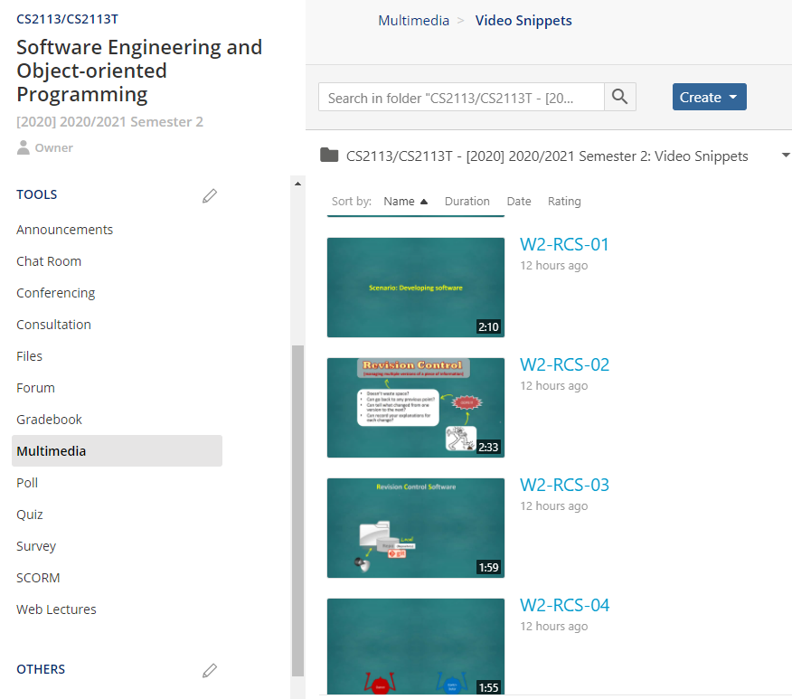
RCS
Watch:

Slide 35


Can John push his code
to Jane’s remote?
1. Yes
2. No
3. Maybe
Answer is Maybe.
If John has write access
(by being a collaborator,
or having been granted
access explicitly) he can
push code to Jane’s
remote.
Jane
Remote
Jane
Local
John
Local
Jane
John

Slide 36
RCS (Demo)
Do these:
init, add/stage, commit, ignore
Git pro tips:
Always have a blank line at the end of the file
Commit subject:
use the imperative mood e.g., Add X, not Adding X, Adding X etc.
Limit line length to 50 chars

Slide 37
GitHub classroom

Slide 38
GitHub Classroom
You will receive a link like this for the assignment: https://classroom.github.com/a/kgObZN9T (this is an example only, not the actual link) [There will be one link per exercise!]
We need to associate your attempt with your student number
You will need 2 things for this
Your GitHub user name that you provided in the pre-module survey
Masked student number of the form #0000000_
E.g., If your student number is A0012345X then the masked student number will be #0012345_

Slide 39
RCS
Watch:

Slide 40
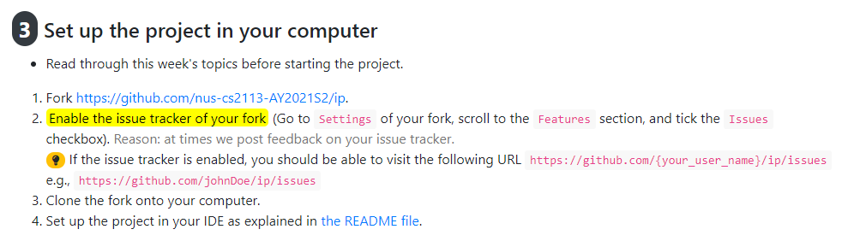
RCS
Activity

Slide 41

$←$✔
$←$✔
$←$✔
$←$✔

Slide 42
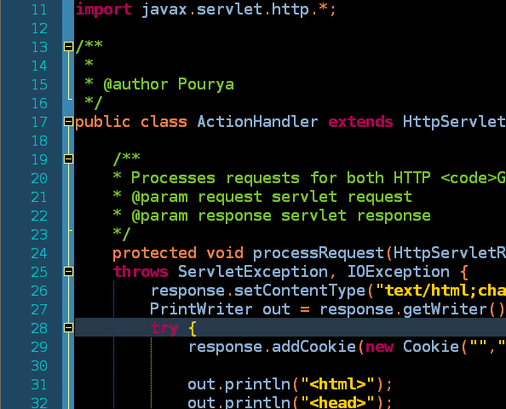
Standardize what?
JUST follow

Slide 43
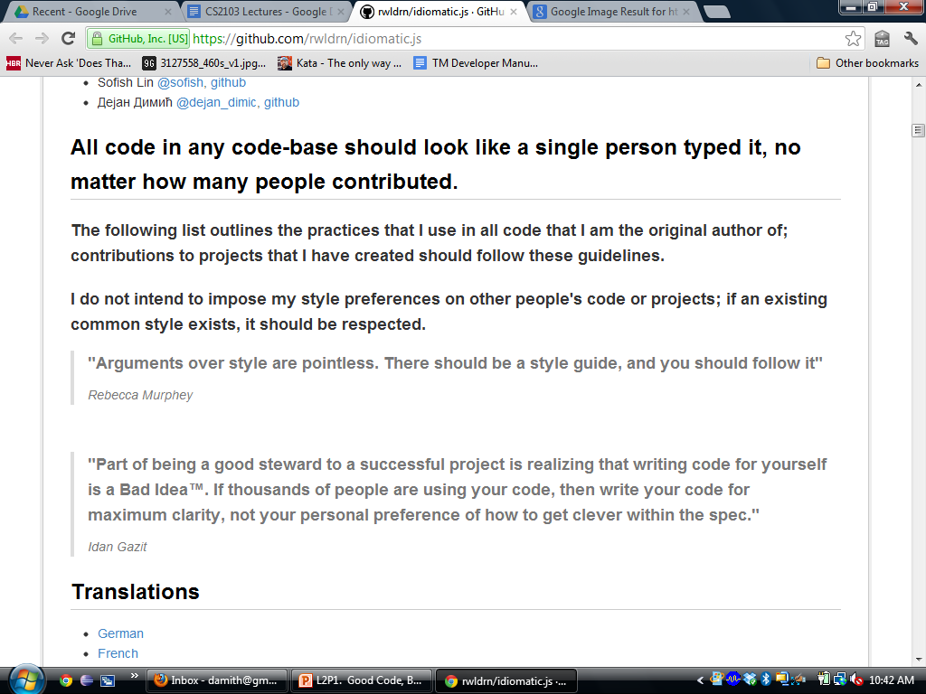
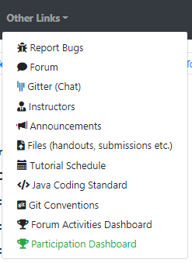

Slide 44

$←$✔
$←$✔
$←$✔
$←$✔
$←$✔

